Slide 1

Problem Statement and Team Details
Problem Statement: Whether it’s preparing an assignment, writing a project report, or doing market research for a startup idea, people spend hours Googling and reading PDFs. The problem is that current tools are fragmented Search engines return pages of links, not concise answers. Chatbots trained on PDFs only work with one file and can’t connect multiple sources. Summarizers often skip citations, making it hard to trust the answer.
Team Name: Dharmayodha.
Team Leader Name: M.ShreeTeja.
Institute Name: K L University
Team Leader Email ID: smutukundu2206@gmail.com

Slide 2
Problem and Solution
Problem:
People spend hours Googling, reading PDFs, and browsing multiple sites for research.
Current tools are fragmented: • Search engines → show links, not direct answers. • PDF bots → work only on one file, no cross-source analysis. • Summarizers → often skip citations, making insights untrustworthy.
This causes wasted time, shallow knowledge, and risk of outdated info.
Students, teachers, researchers, and startups are all affected.
Solution:
Smart Research Assistant • Takes a question as input. • Searches across uploaded docs + live online data. • Summarizes into structured, concise reports. • Provides citations for every fact → ensures trust. • Keeps answers fresh with Pathway (live updates from news/blogs).

Slide 3
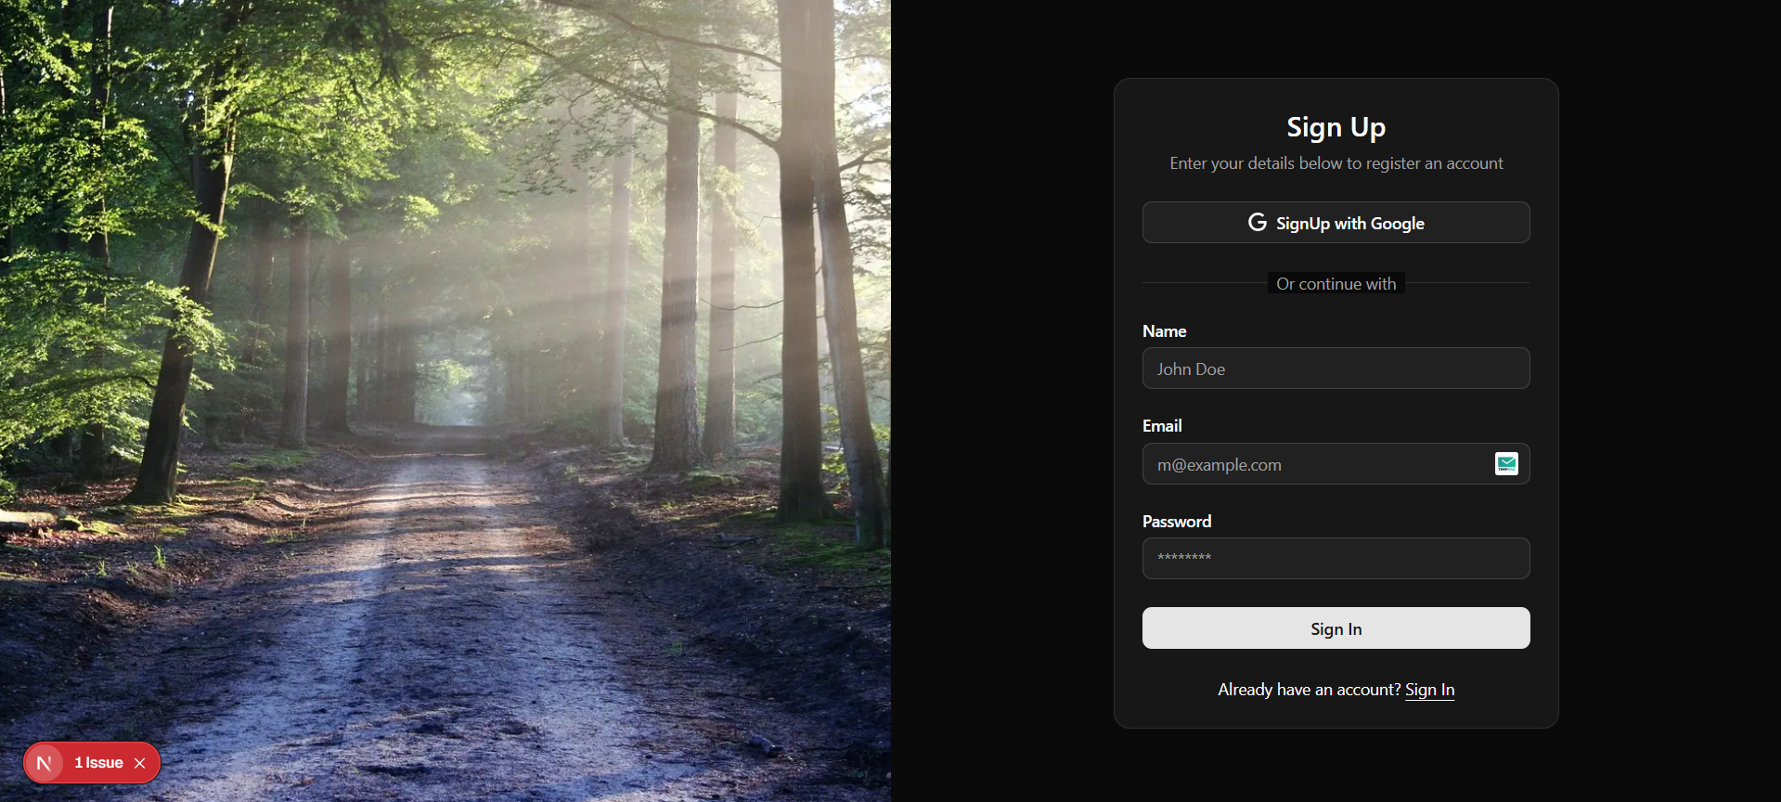
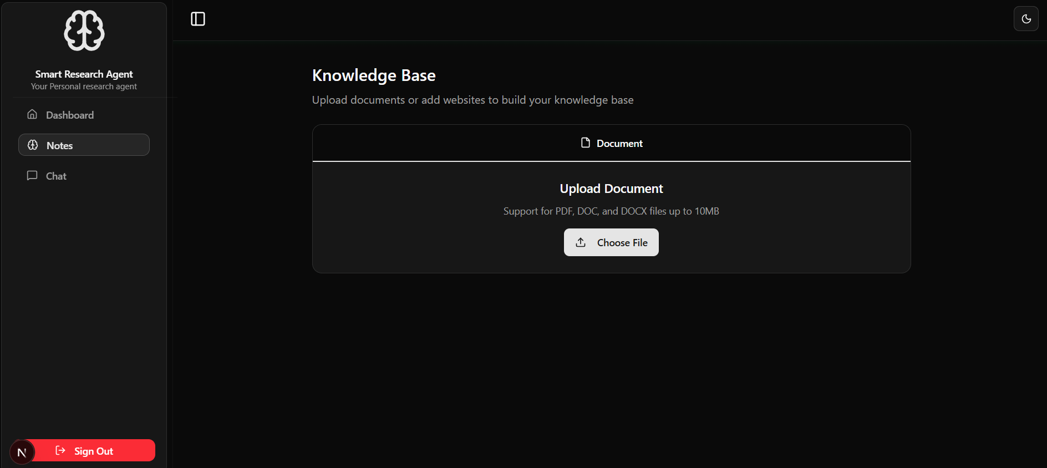
Methodology & Implementation
Problem Understanding
Defined user requirements and analyzed gaps in current solutions.
System Design
Created high-level architecture covering frontend, backend, database, and APIs.
Prototype Development
Built a Minimum Viable Product (MVP) with essential features using agile iterations.
Integration & Testing
Integrated Google Gemini API for intelligent responses.
Conducted unit and integration testing to ensure reliability.
Deployment & Feedback
Deployed using Supabase and Next.js backend.
Collected user feedback for improvements.

Slide 4
Feasibility and Market Use
Feasibility: The project is highly feasible from a technical and economic standpoint, leveraging mature technologies like LLMs for core summarization and specialized tools like Pathway for live data ingestion. The proposed "pay-per-report" SaaS model offers a scalable and viable business strategy with a clear path to profitability.
Market Use: The tool's unique value proposition lies in its ability to synthesize information from multiple, user-uploaded documents, such as project reports or academic papers. It goes beyond single-file chatbots to provide a unified, structured report with citations, effectively saving time and generating trustworthy insights from a user's private knowledge base.

Slide 5



Technology Used
→ Advanced AI-powered insights
1. Next.js → Fast, scalable React framework for SSR/ISR. 2. TypeScript → Strongly-typed language ensuring fewer bugs. 3. Tailwind CSS → Utility-first responsive styling. 4. ShadcnUI → Modern, prebuilt accessible UI components. 5. Google OAuth → Secure, seamless user authentication.
1. Next.js → Unified full-stack framework. 2.TypeScript → Type safety across project. 3. Upstash → Serverless Redis for caching & rate-limiting. 4. Supabase → Scalable database + auth + real-time. 5. Prisma ORM → Type-safe DB queries & schema management.

Slide 6
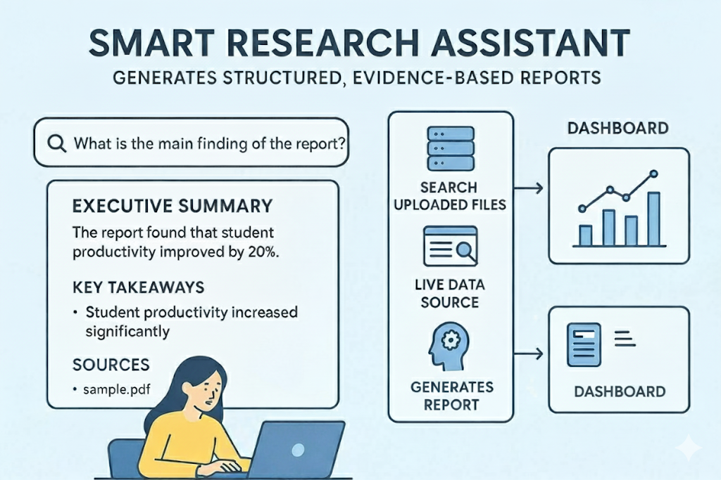
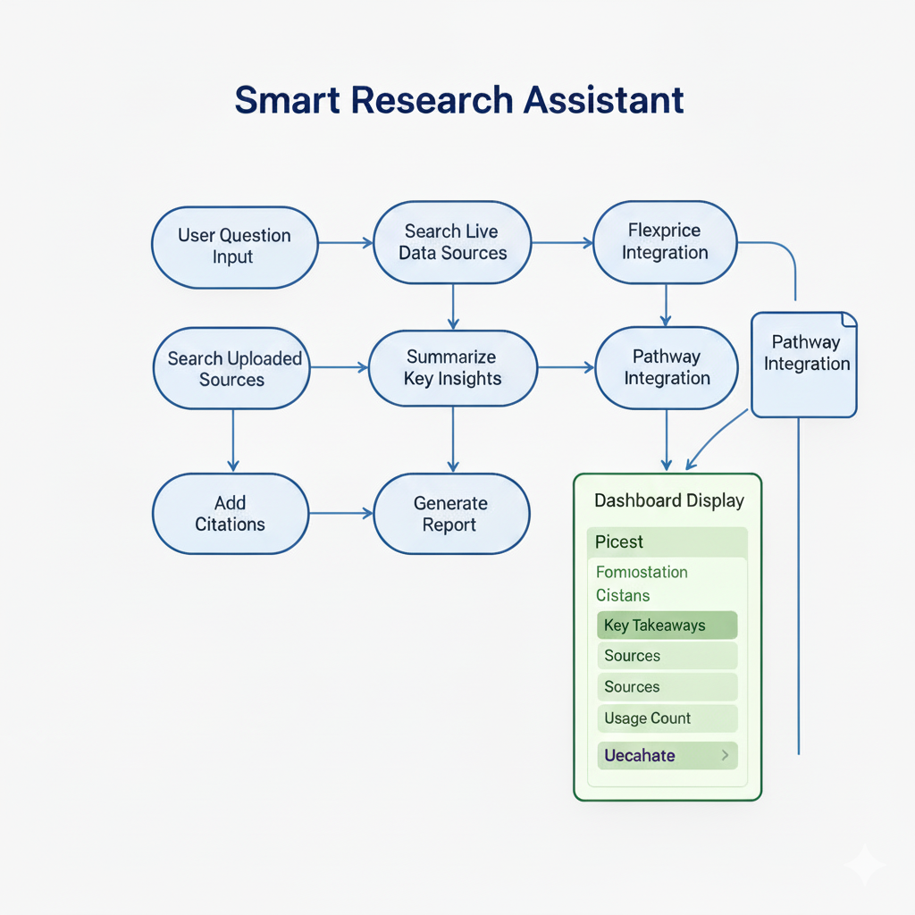
Flowchart & Supporting Images

Slide 7
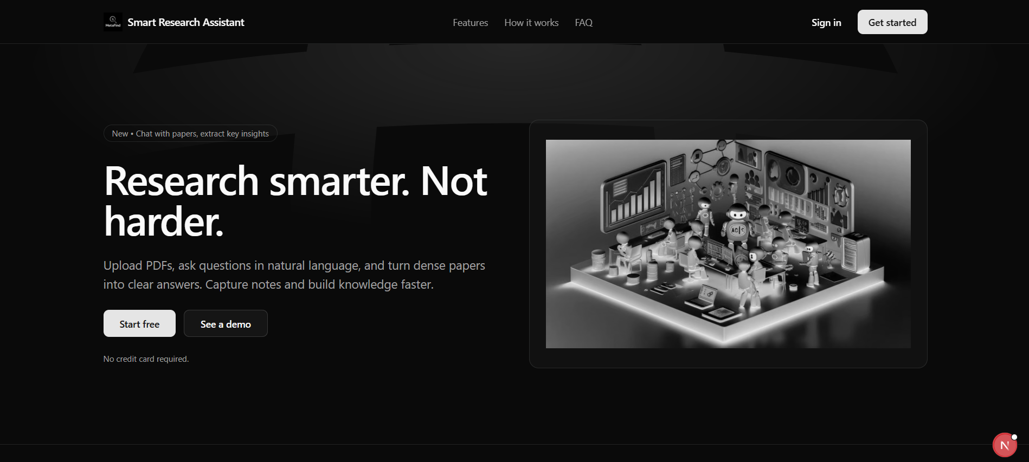
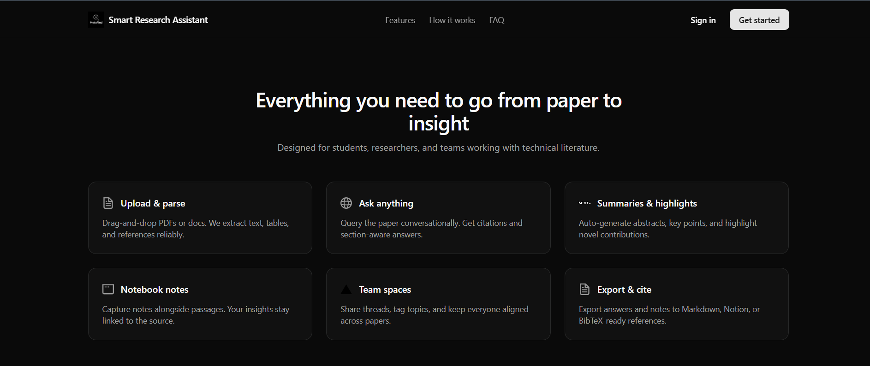
Conclusion
Our solution leverages a modern full-stack architecture with Next.js, Supabase, Prisma, and Upstash to ensure scalability, speed, and reliability.
By integrating Google Gemini API, we enable intelligent, context-aware insights that go beyond traditional systems.
The methodology ensures a user-focused, iterative development cycle, leading to a practical and efficient product.
This project demonstrates the potential of combining AI-driven intelligence with robust backend infrastructure to solve real-world problems effectively.

Slide 8
G​it Hub Repository Link
https://github.com/shreeteja172/Smart-Research-Assistant

